Slide 1
Welcome to My Basic Home Lab Running Active Directory Presentation
Felecia Moore

Slide 2
Agenda
Welcome to my Cybersecurity Analyst portfolio. I am Felecia Moore, a dedicated cybersecurity professional with a passion for protecting digital assets and mitigating security threats. In this portfolio, I hope to showcase my eagerness to learn, grow, and contribute to the ever-evolving realm of cybersecurity. I am excited to share my journey as I continue to develop my skills and seek opportunities to make a meaningful impact in the world of cybersecurity.

Slide 3
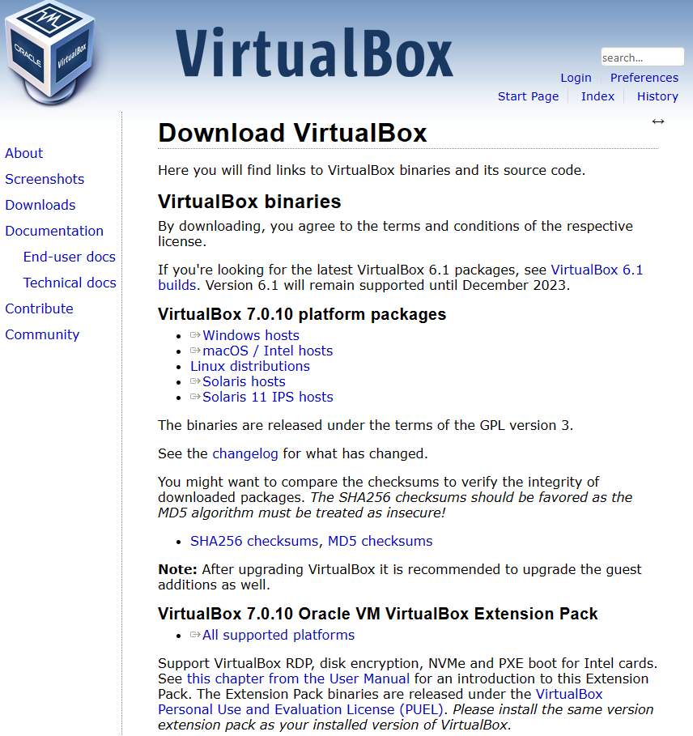
Step 1: Virtual Box and Windows 10
First step was to download and install virtual box and the extension pack for all supported platforms.

Slide 4
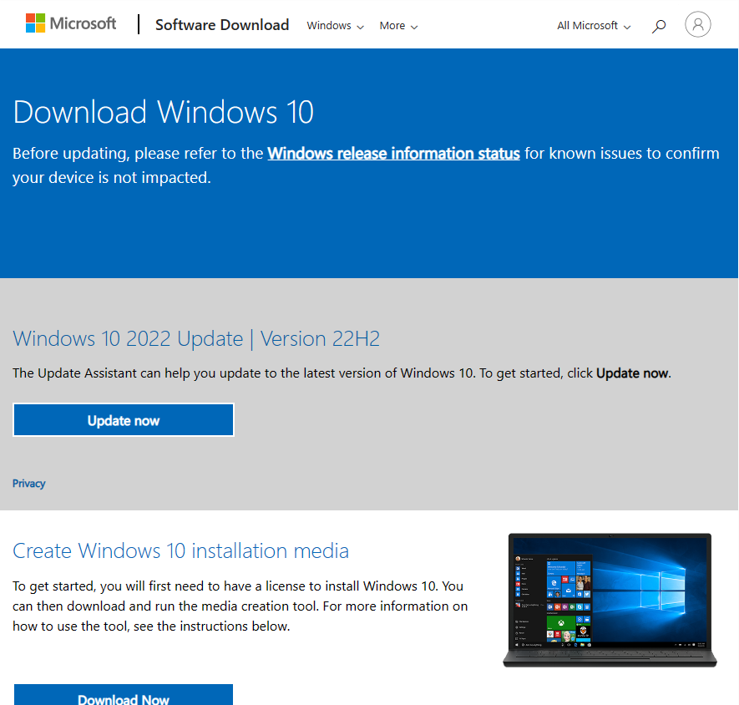
Step 2: Download and install Windows 10
Downloaded and installed Windows 10 64-bit.

Slide 5
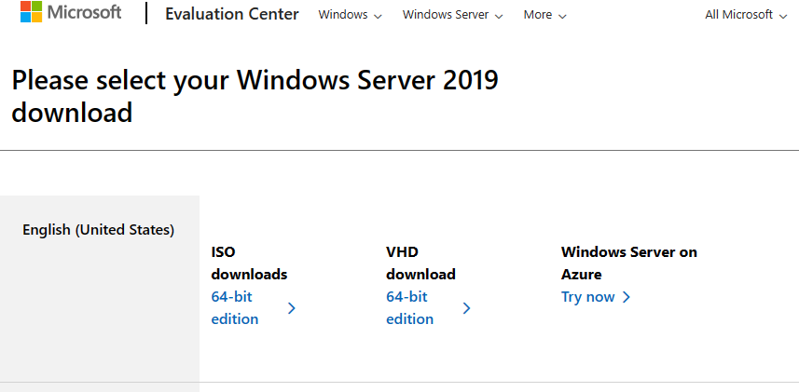
Download Windows Server 2019
Downloaded Windows Server 2019.

Slide 6
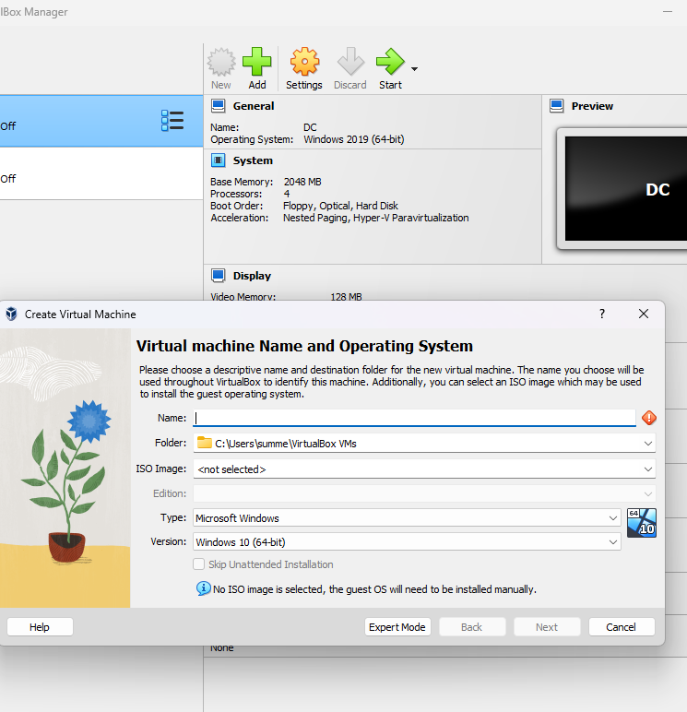
Step 2: Creating the Virtual Machine
After downloading and installing virtual box, I opened my machine and selected “New” to create my domain controller. I made sure to select 64-bit. I gave my domain controller 2048 MB of RAM and continued to create the disk with the defaults. After creating my domain controller, the next step was to edit the settings.

Slide 7
Editing domain controller settings before installing
After creating the domain controller, before I downloaded anything onto the system, I first had to edit some of the settings. The first thing I did was select system, select the advance tab and switched both shared clipboard and drag and drop to bidirectional. Doing this will enable me to be able to drag and drop files between my personal computer and the virtual machine. After this, I went to system and edited my processor to increase the core speed on my CPU from basic to 4 to add some speed to the virtual machine. And lastly, I selected network to set up the network interface card. In this, I set up two network adaptors to allow one to be able to connect to the internet and the other that will run NAT. So, adapter 1 I attached to NAT that will connect to the home network, and adapter 2 will be attached to the internal network.

Slide 8
Installing the DC controller
After clicking ok in the settings, I proceeded to click on the DC controller within the Virtual Box platform to start the first run. After opening the file folder designated to choose the program, I was able to select the Server 2019 ISO file of which I had downloaded in the very beginning of the slides and then using it to start the virtual machine (contents of the domain controller).

Slide 9
Creating the domain controller
After clicking NEXT in the start up to install the Windows Server 2019 Standard Experience (the file that has the GUI included), I accepted the license agreements, chose the option for the custom install selecting Drive 0 Unallocated Space to custom install the server on the hard drive.

Slide 10
Server Configuration
After installing and configuring my domain controller, the next step was as follows:
Setting up IP addressing
Installing Active Directory domain services
Creating own dedicated domain on the VM
Creating the organizational unit on the VM
Creating new users on the VM
Configuring routing and remote access
Installing NAT’s
Setting up DHCP server
Configuring the lease duration
Configuring DHCP options
Adding the IP address for the router on the VM

Slide 11
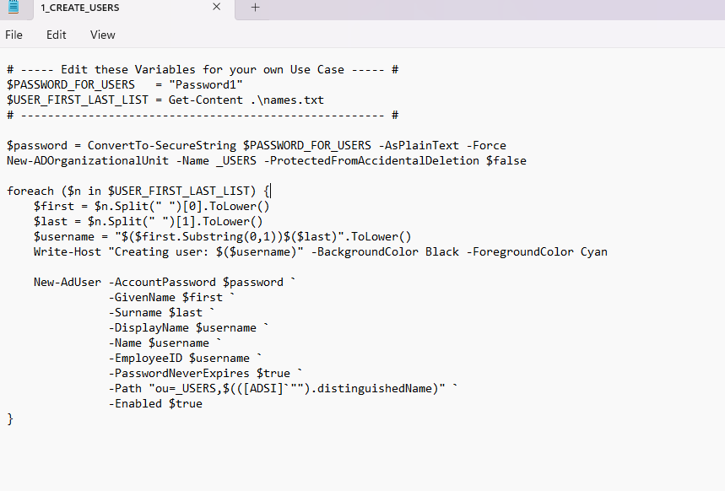
PowerShell Scripting
Using this PowerShell script, I was able to generate a list of users in Active Directory.

Slide 12
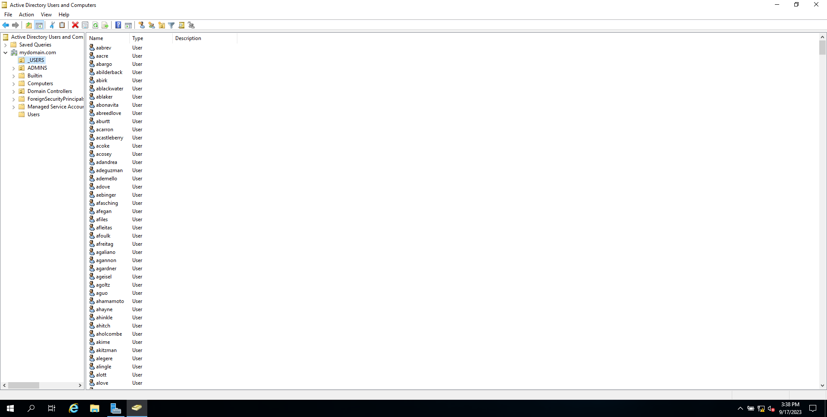
List of over 1000 users in Active Directory

Slide 13
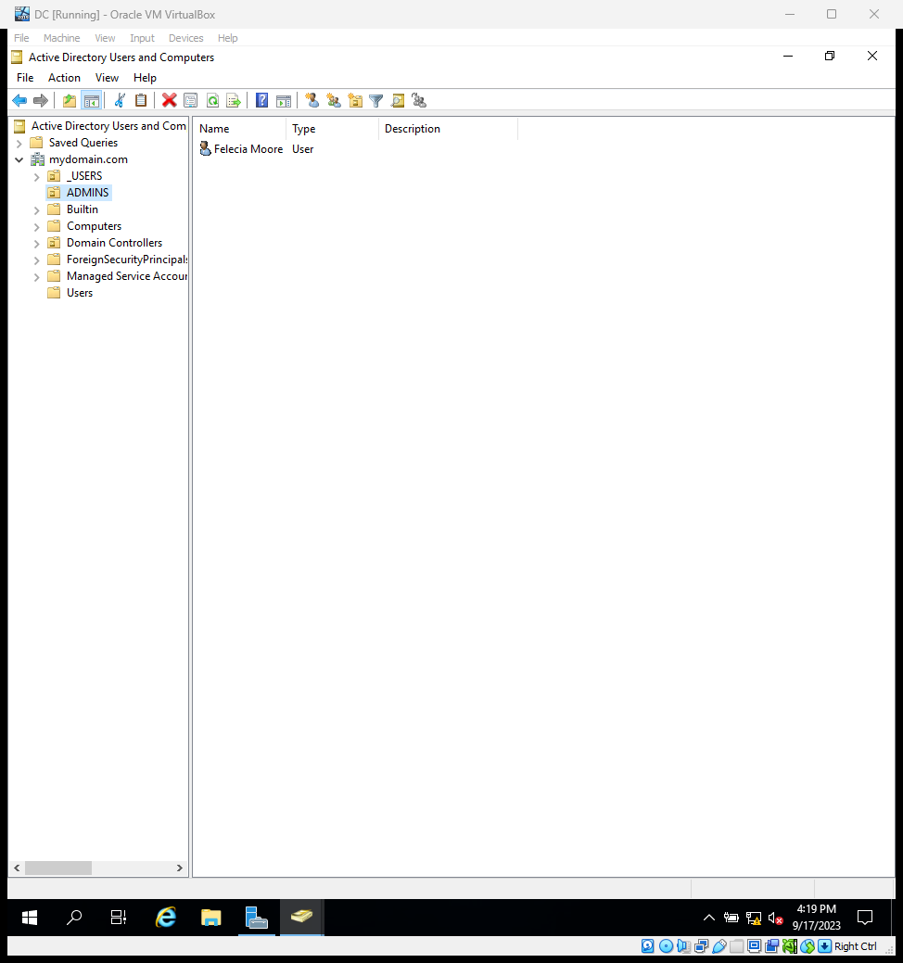
Administrative Account Verification

Slide 14
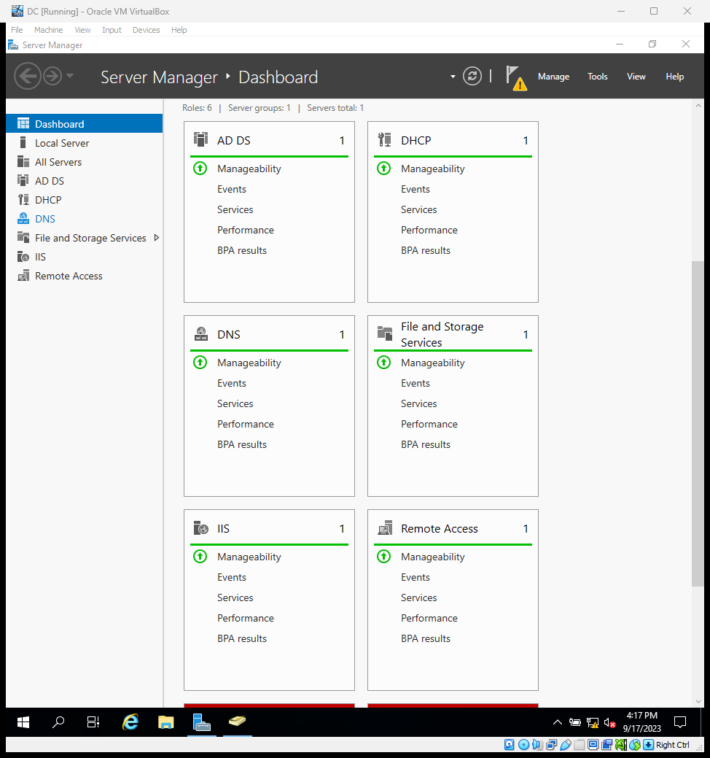
Server Manager Dashboard

Slide 15
Set up Overview
Client 1 has an internal and external network NIC in which the internal NIC (DHCP) will get addressing from the domain controller while the external NIC has the IP address set to 172.16.0.1 and a mask of 255.255.255.0. The DNS server address is set to 127.0.0.1. The domain/AD DS FQDN is set to mydomain.com. The RAS/NAT is set so that the outside is connected to the internet and the Inside is internal. The DHCP (1 scope) has a range of 172.16.0.100-200.

Slide 16
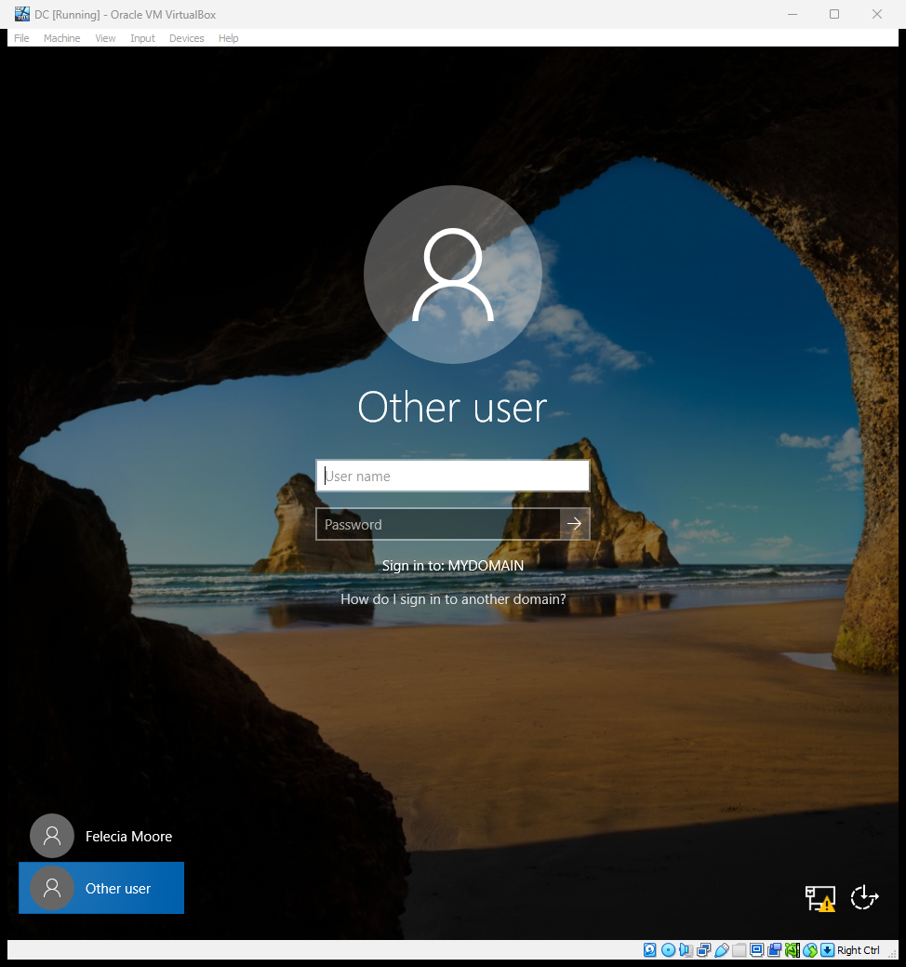
Windows 10 client/New User Access

Slide 17
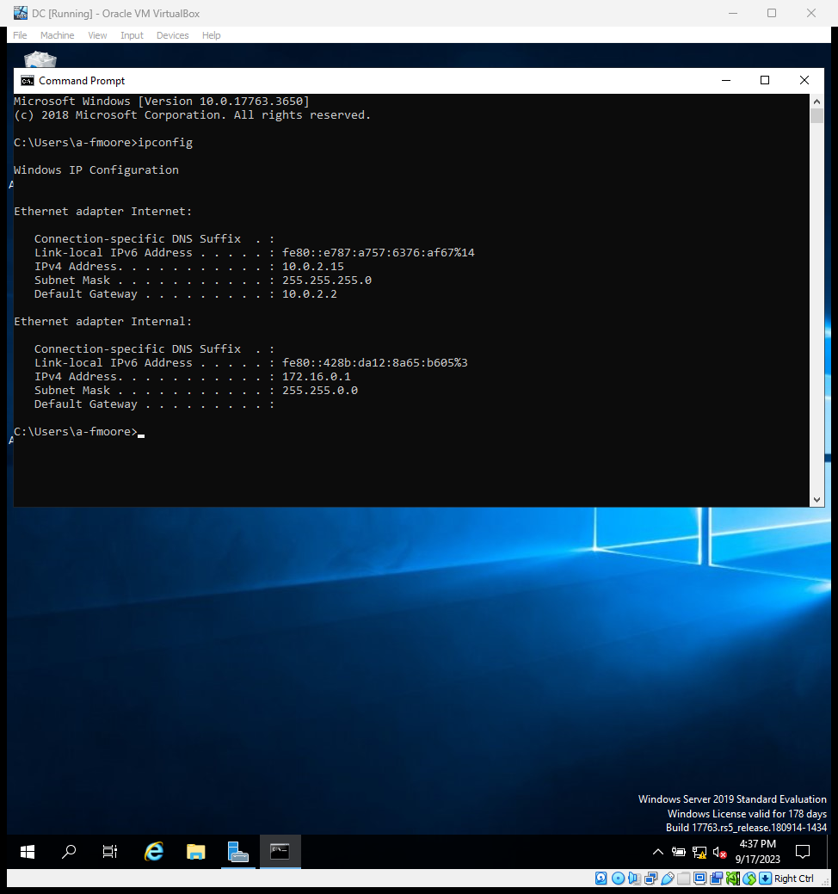
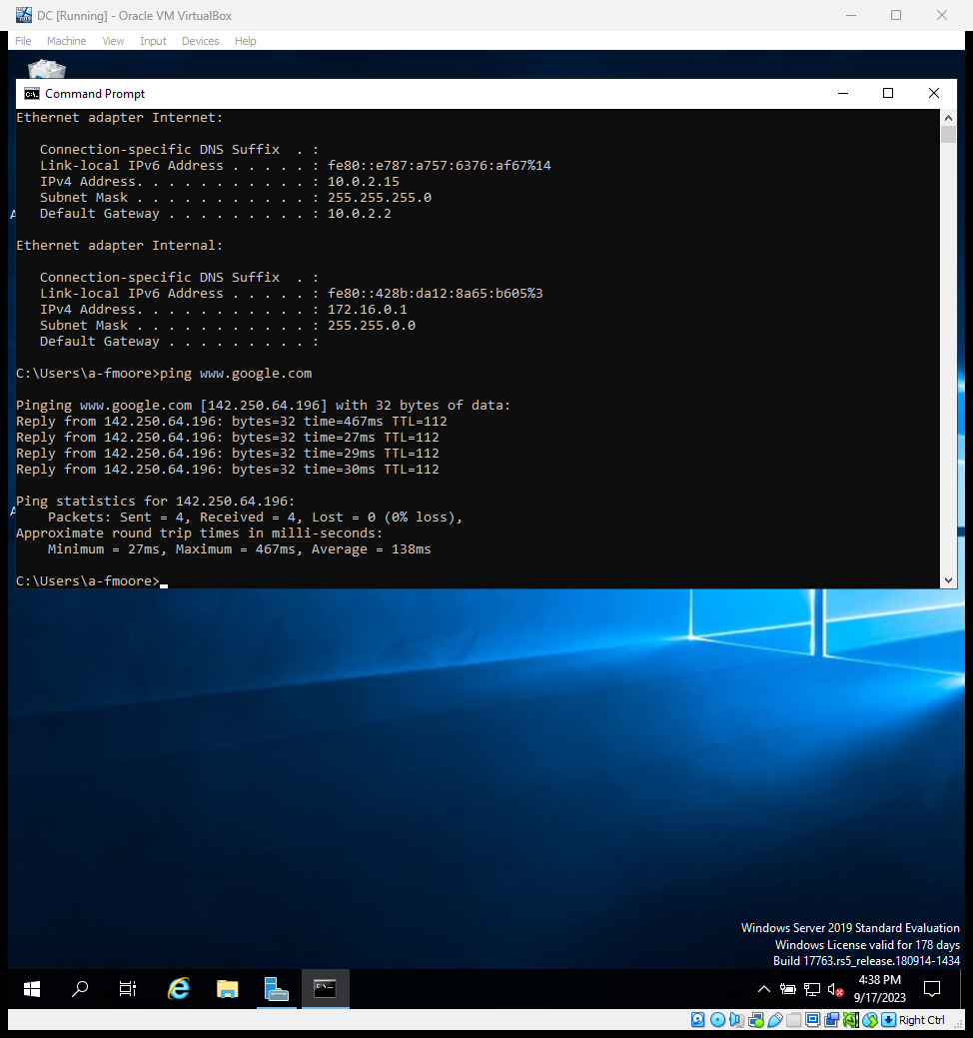
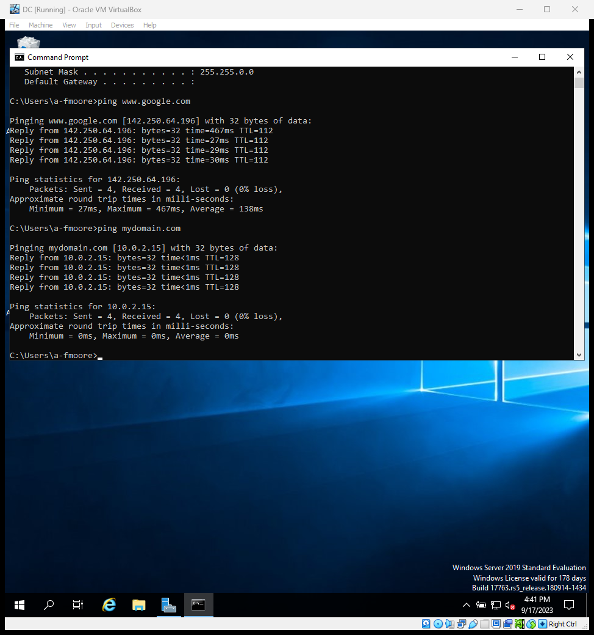
IP Configuration & infrastructure check

Slide 18
Synopsis of Skills
Downloading and Installing Virtualbox
Downloading and installing windows 10 on virtual computer
Creating and setting up virtual machines
Setting up IP addressing inside of virtual machine
Installing active directory domain services in a virtual machine
Creating own dedicated domain on the virtual machine
Creating new users on the virtual machine
Installing NATs on virtual machine
Setting up DHCP Server on the domain on a virtual machine
Adding an IP Address for a router on a virtual machine
Using source code with a PowerShell script on a virtual machine
Installing and configuring Windows 10 Virtual Machine on Virtual Box
Creating a new VM
Configurating new user on a VM
Adding the domain controller on the virtual machine
Configuring the address leases on a virtual machine
Viewing Active Directory Users and Computers on a Virtual Machine

Slide 19
Thank you
Felecia L. Moore​
summerrose1734@gmail.com

